Slide 1
When to Buy a House in SF
By: Eric Castellanos, Russell Chan, and Katelyn Wu

Slide 2
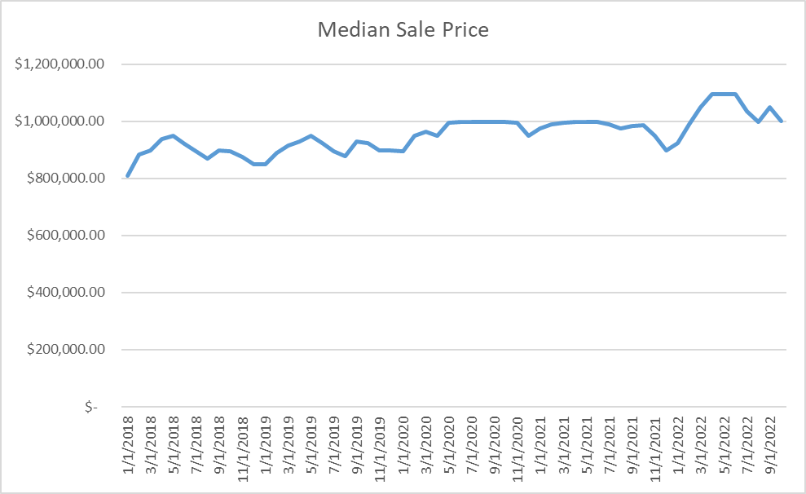
The Data
The data used for our project is from Zillow. It is the raw data of all homes sold in San Francisco.
Visually, we can see seasonality, a slight upward trend, and cycles in only 2018 and 2019.
The cycles stop at around march 2020, around the start of the global pandemic.
The cycle returns at the beginning of 2022.

Slide 3
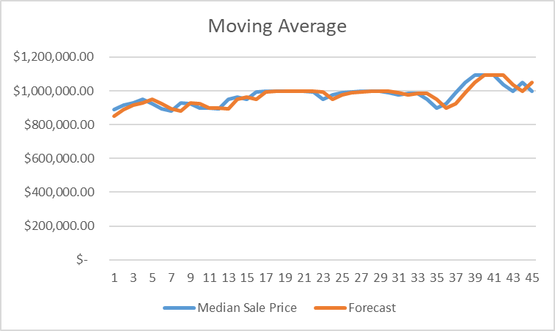
Moving Average
Moving Average is typically used for stable time series, and smoothing data.
Typically used for stationary data patterns.
RMSE = 30164.62

Slide 4
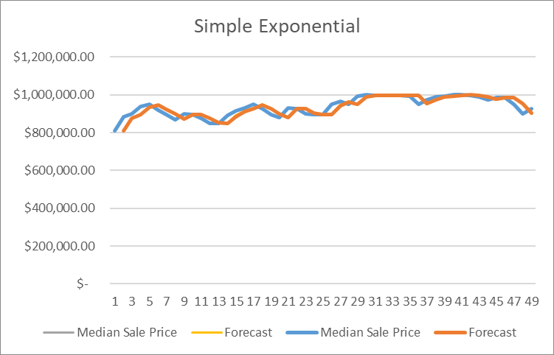
Simple Exponential Smoothing
Is another smoothing forecast.
It is used for stationary data.
It requires a single parameter, called alpha, also called the smoothing factor or smoothing coefficient.
The alpha that provided the lowest RMSE, α = 0.9.
RMSE = 26716.34

Slide 5
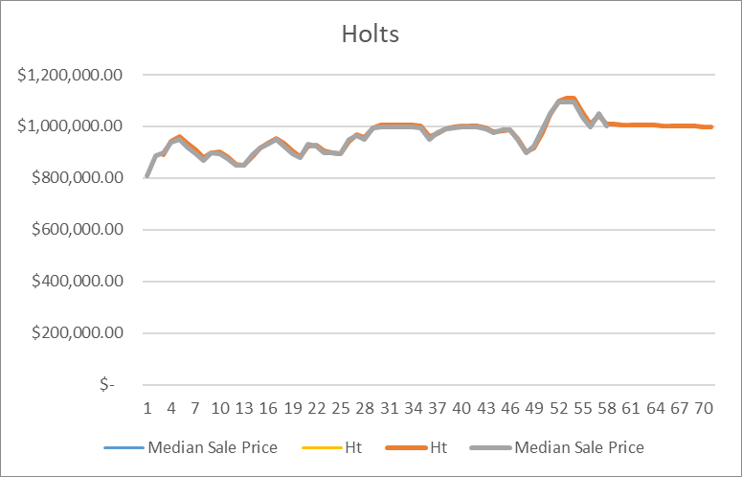
Holts Forecast
Holts forecasting method is used for data with trend.
There is an apparent upward trend for this dataset.
Holts requires two parameters, alpha and beta, for the level and trend, respectively.
The best parameters were α = 0.9 and β = 0.1.
RMSE = 7075.69

Slide 6
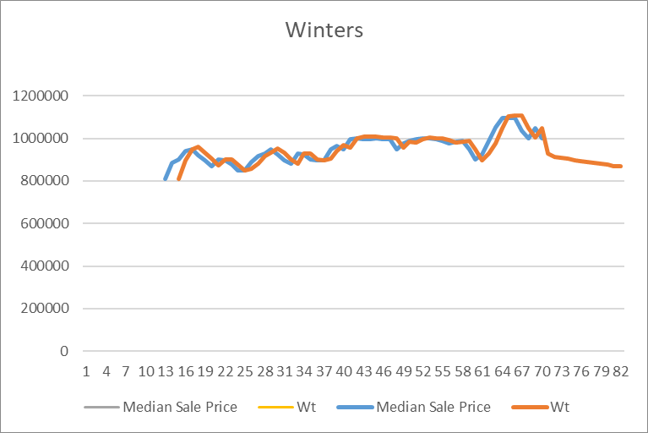
Winters Forecast
Winters forecasting method allows for seasonal factor.
It is an extension of Holts and it factors in both trend and seasonality.
Winters uses three parameters, alpha, beta, and gamma for the level, trend and seasonality, respectively.
The best parameters were α =0.9, β = 0.1, γ = 0.1.
RMSE = 33105.44

Slide 7
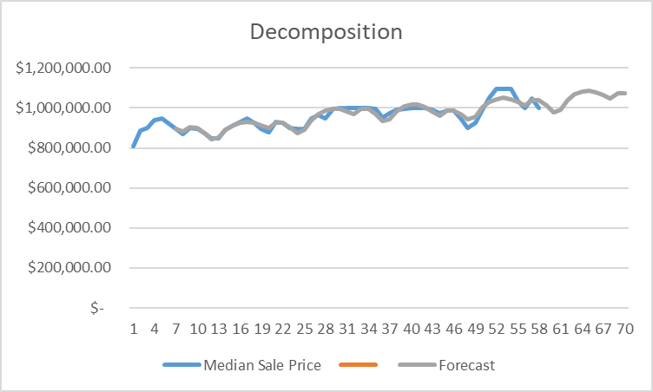
Decomposition
Decomposition forecasting method includes four components.
Trend
Seasonality
Cycle
Irregularity
Random variation
RMSE = 455208.23
We believe the high RMSE is caused by the absence of cycles during the pandemic.

Slide 8
Summary
December and January is where we recommend to purchase a house
Forecast | RMSE
Moving Average | 30164.62
Simple Exp. Smoothing | 26716.34
Holts Forecast | 7075.69
Winters Forecast | 33105.44
Decomposition | 455208.23
Holt’s gives the best prediction because it predicts seasonal trends by exponentially weighted moving averages

Slide 9
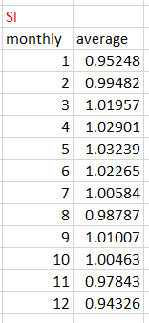
Conclusion
Decomposition had the worst RMSE due to lack of cycle factors. The seasonal indices show November, December and January had a slight decrease sale price.
Even if we predict Dec/Jan to be the best time to buy a house, market is unpredictable due to too many outside factors such as inflation, the economy’s health, climate change, or housing demand.
The best time to buy a House in San Francisco is around the end or beginning of the year.

